Slide 1
Coursera capstone IBM Data Science capstone Opening a New Shopping Mall in Hyderabad
By
Manjith Reddy Vennapusa
09-10-2020

Slide 2
Business problem
Location of the shopping Mall is of prime importance in deciding whether the shopping Mall will succeed or Not?
Objective: To analyse and suggest the best neighbourhoods to open a New Shopping Mall in Hyderabad city
This project is Timely as a big infrastructure boom is taking place in the city along with rapid population growth in the city
Business question: If a property developer is looking to open a New shopping Mall in Hyderabad city then what neighbourhoods will you suggest him?

Slide 3
Data
Data Required
List of Neighbourhoods in Hyderabad city
Latitude and Longitude Coordinates of the Neighbourhoods
Venue data, particularly data related to shopping Malls
Source of Data
Wikipedia page for neighbourhoods
https://en.wikipedia.org/wiki/List_of_neighbourhoods_in_Hyderabad
Geocoder package for latitude and longitude coordinates
Foursquare API for Venue data

Slide 4
Methodology
Web scraping Wikipedia page for neighbourhoods list
Get Latitude and Longitude Coordinates using Geocoder
Use Foursquare API to get Venue Data
Group Data By Neighbourhood and taking the mean of the frequency of occurrence of each venue category
Filter Venue Category By Shopping Mall
Perform Clustering on the Data by using k-means Clustering
Visualize the clusters in a map using Folium

Slide 5
Results
Categorize the Neighbourhoods into three clusters:
Cluster 0: Neighbourhoods with Moderate Number of Shopping Malls
(Red colour clusters)
Cluster 1: Neighbourhoods with Low Number of Shopping Malls
(Purple colour clusters)
Cluster 2: Neighbourhoods with Highest Number of Shopping Malls
(Mint Green colour clusters)

Slide 6
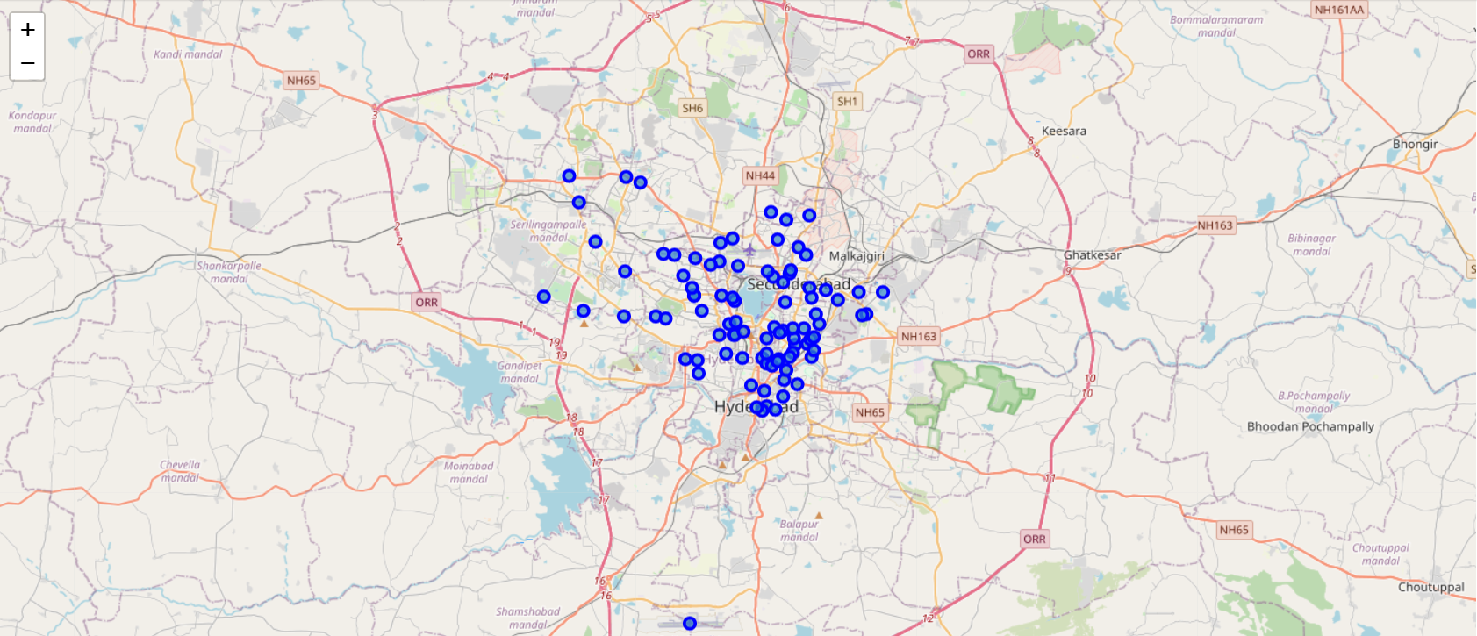
Before Clustering

Slide 7
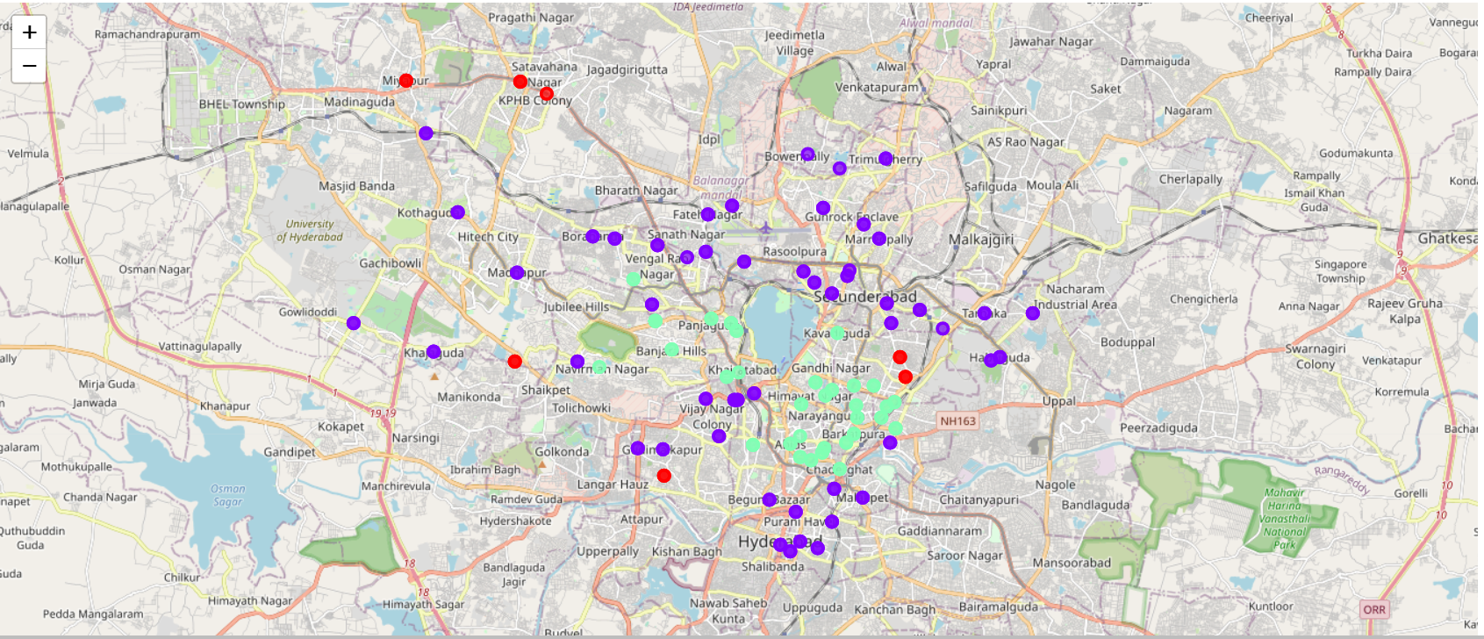
After Clustering

Slide 8
Discussion
Most of the Shopping Malls are concentrated in the central area of the city
Highest Number of Shopping Malls in Cluster -2 and Moderate Number of Shopping Malls in Cluster - 0
Cluster-1 has very low number of shopping Malls in the Neighbourhoods

Slide 9
Recommendations
Can Open a New Shopping Mall in Neighbourhoods in Cluster 1 with little to no competition
Can Open a New Shopping Mall in Neighbourhoods in Cluster 0 with moderate competition if you have unique selling propositions and can stand out in the competition
Avoid Neighbourhoods in Cluster 2 as they are concentrated with highest number of Shopping Malls and will face high competition and highly difficult to succeed unless you standout in the competition

Slide 10
Conclusion
Answer to Business question: The Neighbourhoods in Cluster 1 are the most preferred locations to open a New Shopping Mall
Findings of this project will help the relevant stake holders to capitalize on the Opportunities in high potential Locations while avoiding the overcrowded areas in their decision to open a New Shopping Mall

Slide 11

Thank you

